Slide 1
Performance analysis and optimization of a multithreaded application using intel vtune
Debopama Basu
Roll number: 152402006
m.Tech system-on-chip design
Indian iinstitute of technology palakkad

Slide 2

Introduction
In modern world, applications are designed to run multiple tasks at once using multithreading.
Developers face challenges like threads competing for the same resources, the overhead of keeping them in sync, and making sure memory is accessed efficiently.
That’s where tools like Intel® VTune™ Profiler come in.
In this project, we use VTune Profiler to analyse a multithreaded tiled matrix multiplication program.
Using VTune, we identify performance bottlenecks, examine how well the threads are working together, and explore ways to make the program even faster.

Slide 3
WHAT IS INTEL VTUNE?
The Intel VTune Profiler is an analysis and tuning tool that addressees performance issues based on the following analysis types:
Performance Snapshot: for overall performance analysis
Hotspots: points out functions with high CPU time (more than 5% of the clock ticks)
Threading: how effectively threading and parallelism has been used
Memory Consumption: analyses memory usage and call stack allocation
Microarchitectural exploration: analyses the microarchitectural bottlenecks
HPC performance: analyses CPU and GPU usage of compute intensive functions

Slide 4
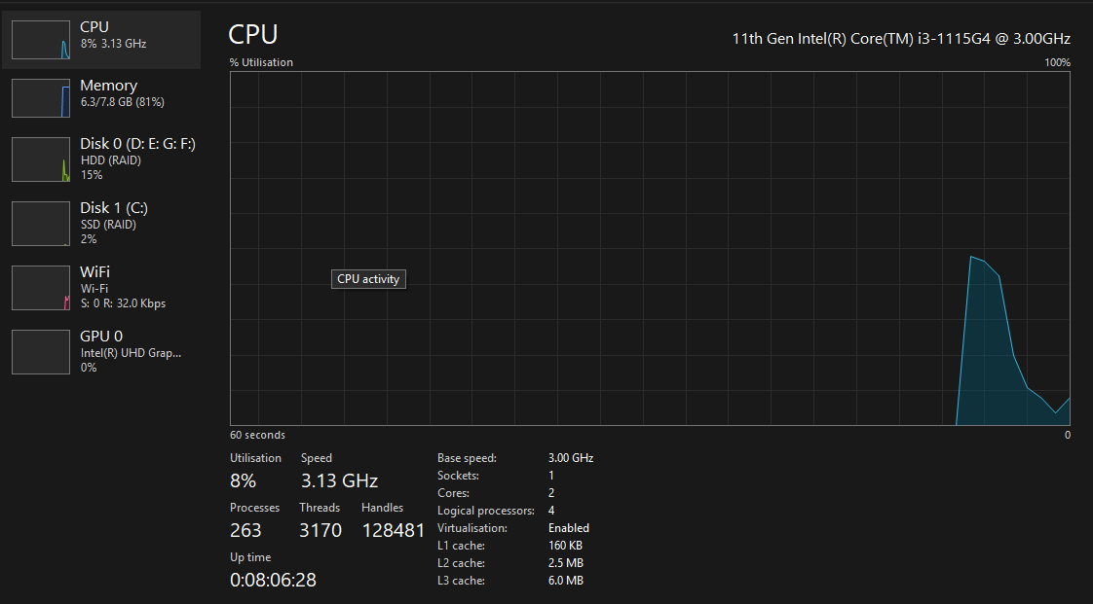
Laptop specifications

Slide 5
CODE Optimisation flow
Tiled Matrix Multiplication with pthread for multithreading
Tiled Matrix Multiplication with pthread using hierarchical tiling method
Tiled Matrix Multiplication with OpenMP for multithreading
Tiled Matrix Multiplication with OpenMP and vectorization

Slide 6
Related work
In the paper "Performance Analysis and Optimization of Parallel Applications" by A. Murawka, published in the Journal of High Performance Computing (Vol. 40, No. 5, pp. 1342–1360, 2017), the author presents a systematic methodology for analyzing and optimizing the performance of parallel applications. The paper introduces the Top-Down Microarchitecture Analysis Method, which categorizes performance bottlenecks into Frontend Bound, Backend Bound, Bad Speculation, and Retiring. Murawka emphasizes the use of tools like Intel VTune Profiler to collect detailed hardware metrics, guiding developers in identifying inefficiencies in code execution. The study demonstrates how this analysis approach can be effectively applied to real-world applications to improve CPU utilization, reduce stalls, and optimize multi-threaded execution performance.

Slide 7

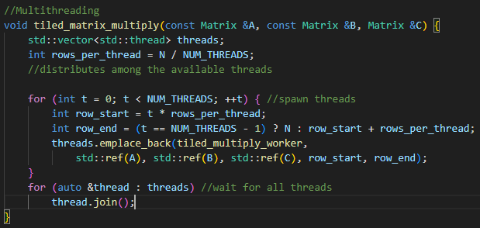
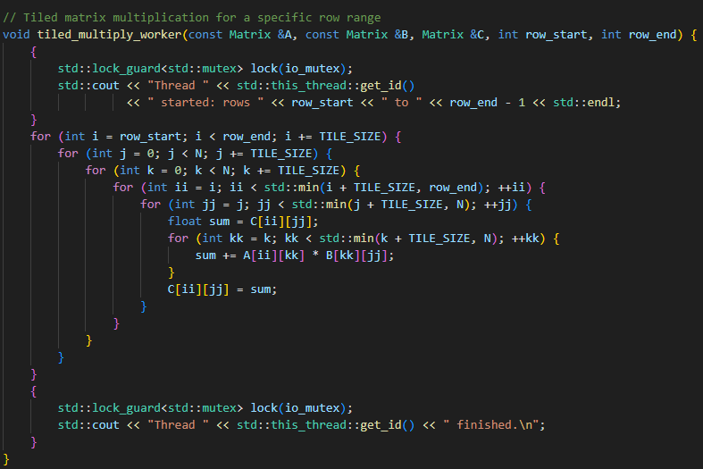
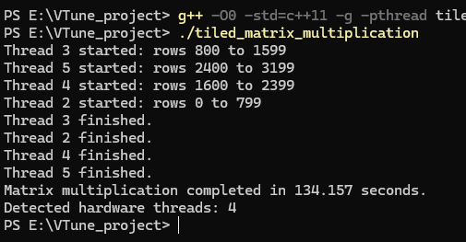
Basic Tiled matrix multiplication code

Slide 8
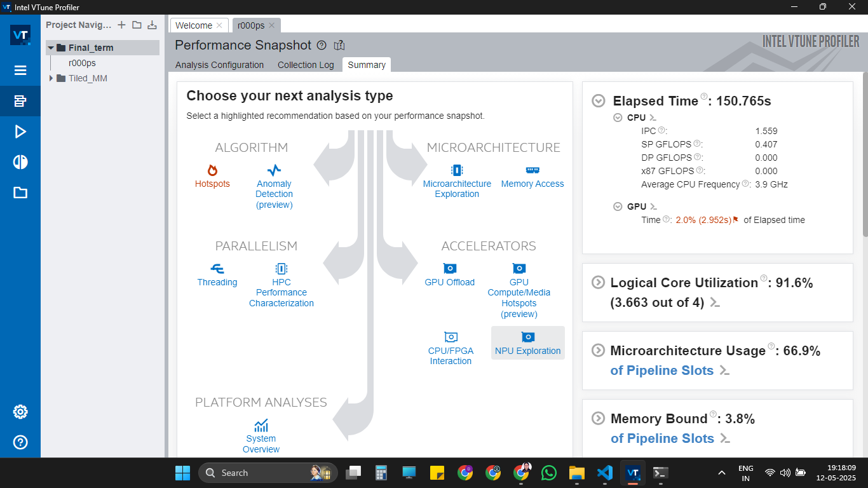

Slide 9
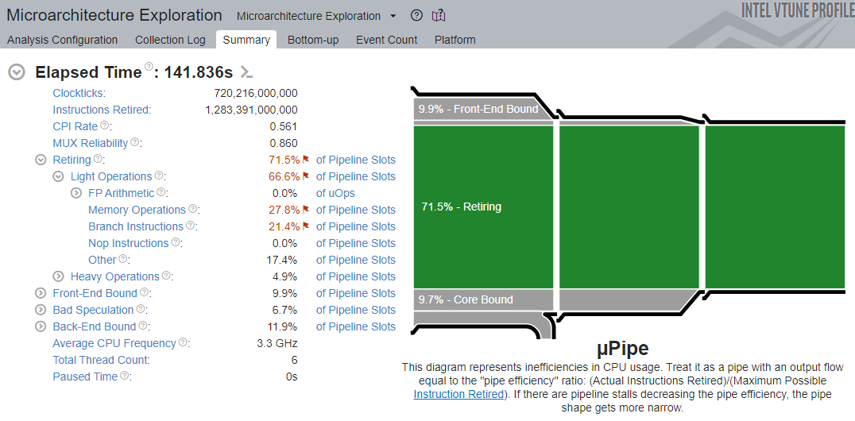
Microarchitectural exploration

Slide 10
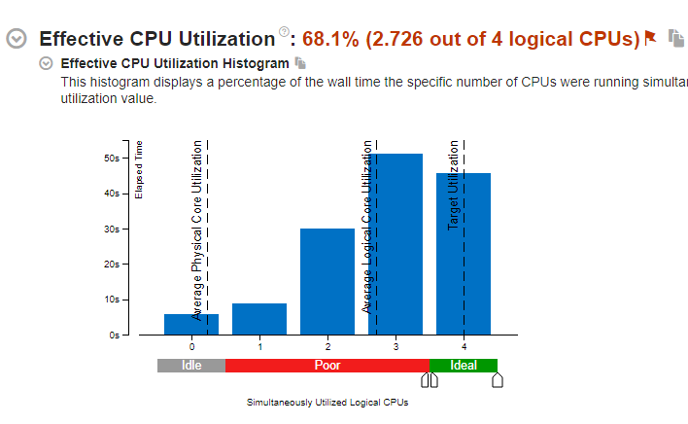
Effective physical Core utilization

Slide 11
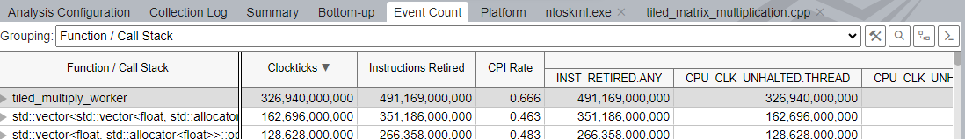
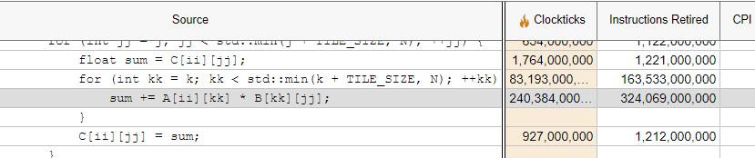
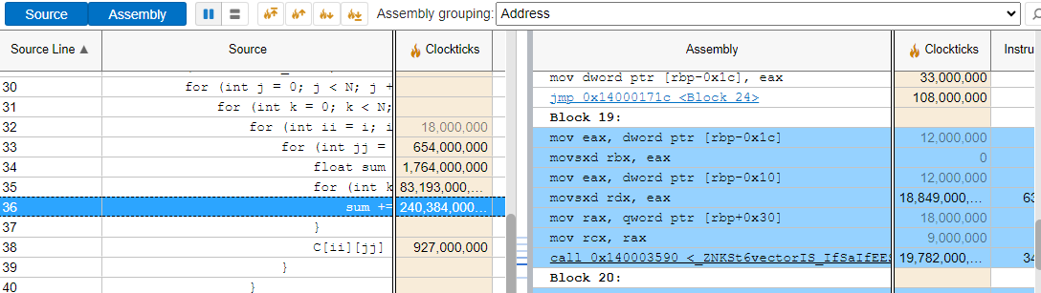
Analysis of functions taking most cpu time: 240 billion clockticks.

Slide 12
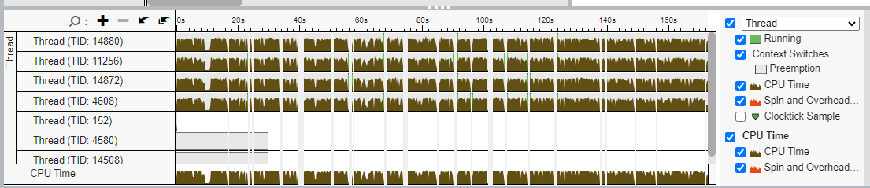
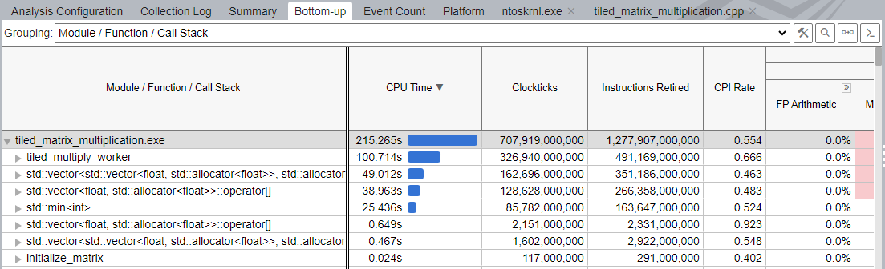
CPU Utilisation of 4 threads

Slide 13
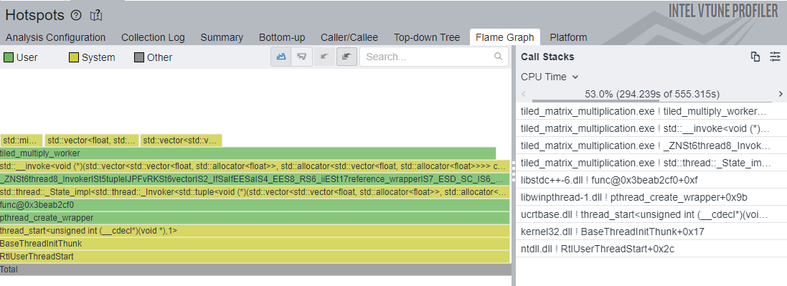
Flame graph analysis
🔥 What is a Flame Graph?
A flame graph shows call stacks, with each box representing a function.
The width of each box corresponds to the amount of CPU time spent in the functions
The y-axis shows the call stack depth — the higher the box, the deeper it is in the call hierarchy
Green (User): Time spent in the application code.
Yellow (System): Time spent in system/library/kernel functions.
Grey or Other: Miscellaneous or unknown time.

Slide 14
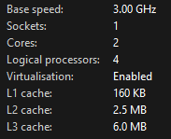
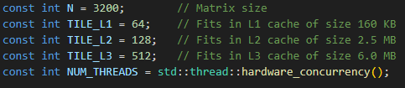
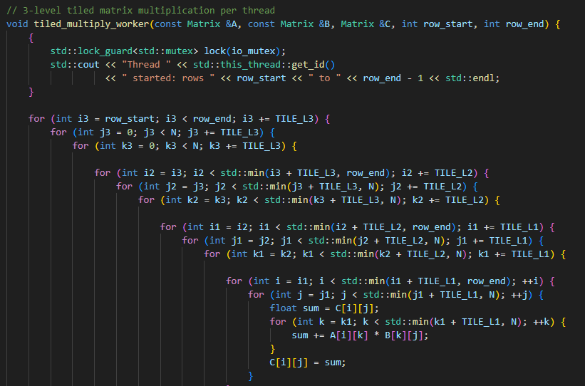
Optimising for cache utilisation: 3 tiling method
Used System Specification

Slide 15
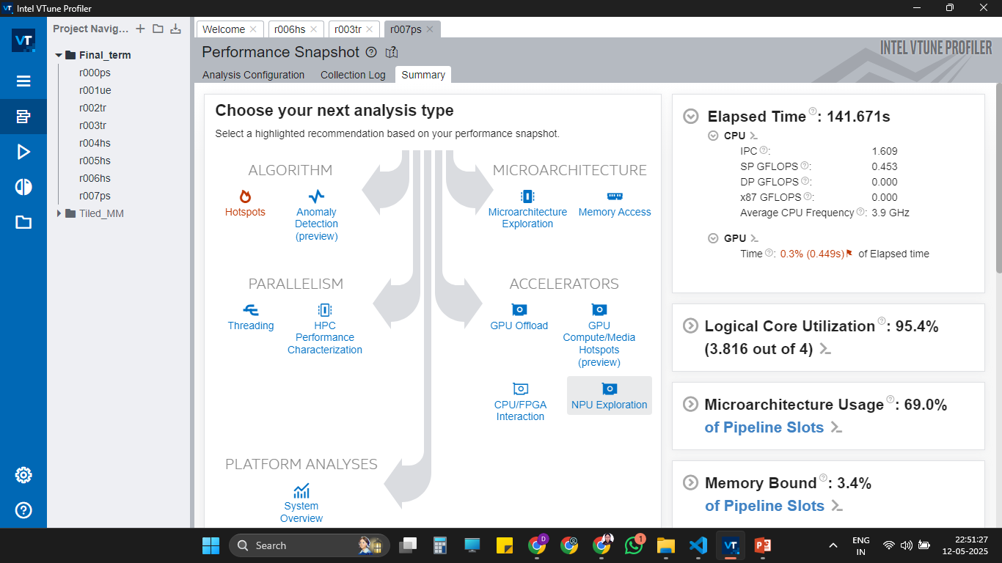

Slide 16
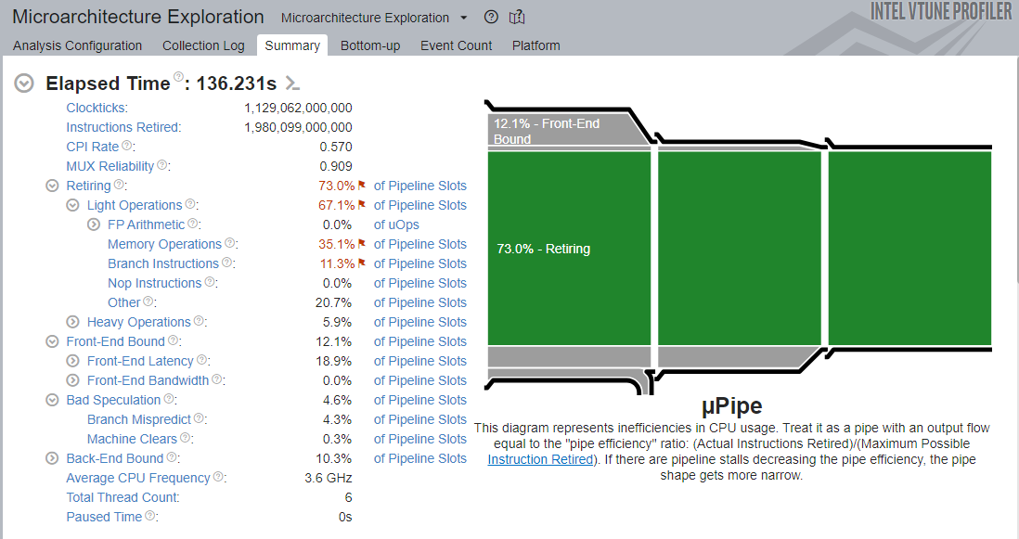
Performance Improvement ->

Slide 17
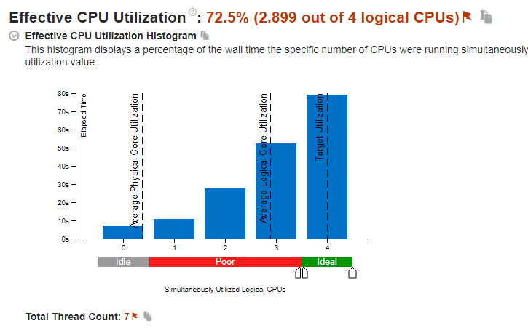
Performance Improvement ->

Slide 18


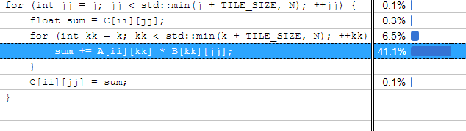
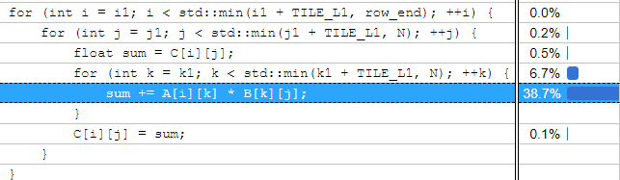
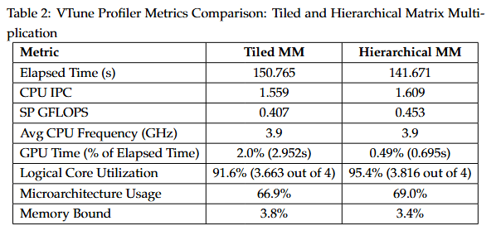
Performance Improvement ->

Slide 19
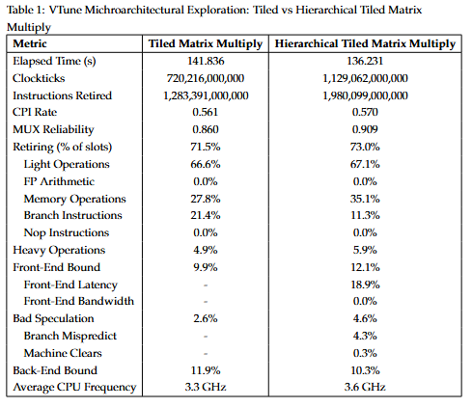

Slide 20
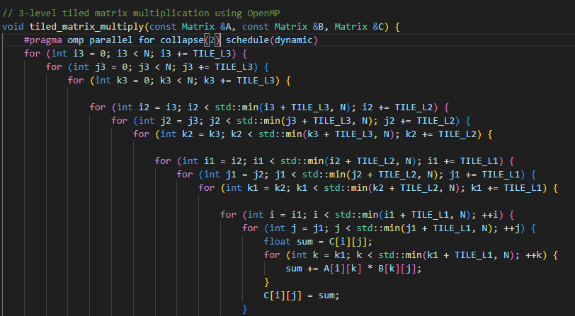
Optimising for cpu utilisation : OPENMP METHOD
#pragma omp parallel for tells the compiler to parallelize the following for loop using multiple OpenMP threads.
collapse(2) combines the first two nested loops into a single iteration space, allowing OpenMP to distribute work more evenly across threads.
schedule(dynamic) assigns chunks of loop iterations to threads at runtime, which helps balance uneven workloads.

Slide 21
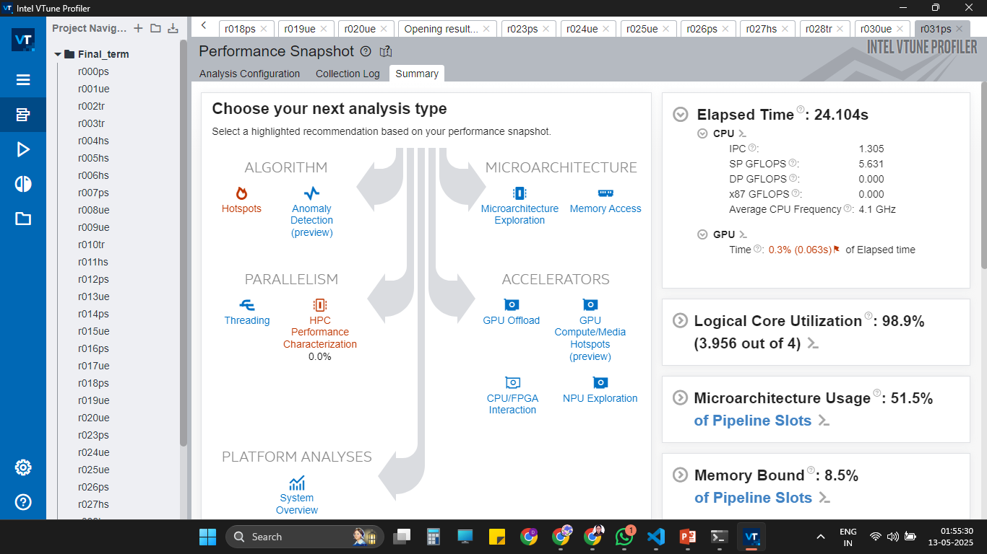

Slide 22
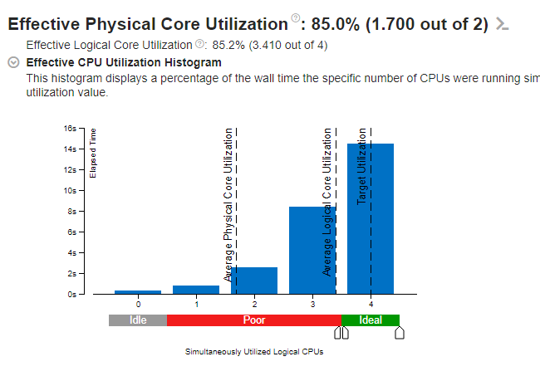
Performance Improvement ->

Slide 23
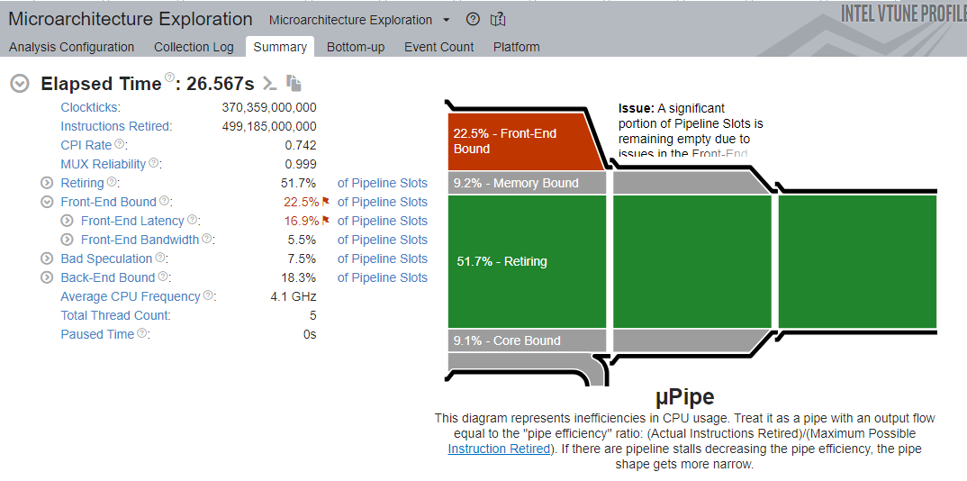

Slide 24
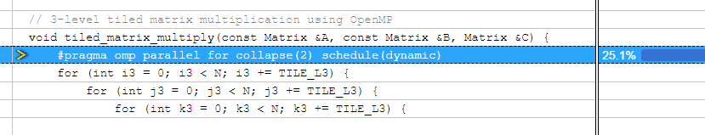

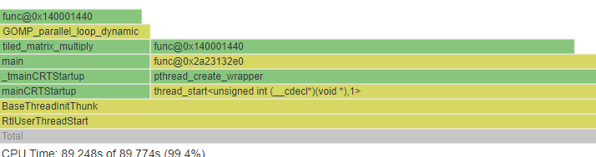
Performance Improvement ->
Performance Improvement ->

Slide 25
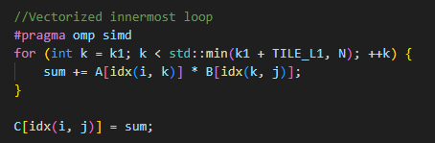
Optimising for cpu utilisation : flattened matrix + Vectorization
#pragma omp simd tells the compiler to use vector instructions and execute multiple loop in parallel at the hardware level using SIMD registers
Flattened matrix stores 2D array in 1D improves cache locality and pointer indirection overhead

Slide 26
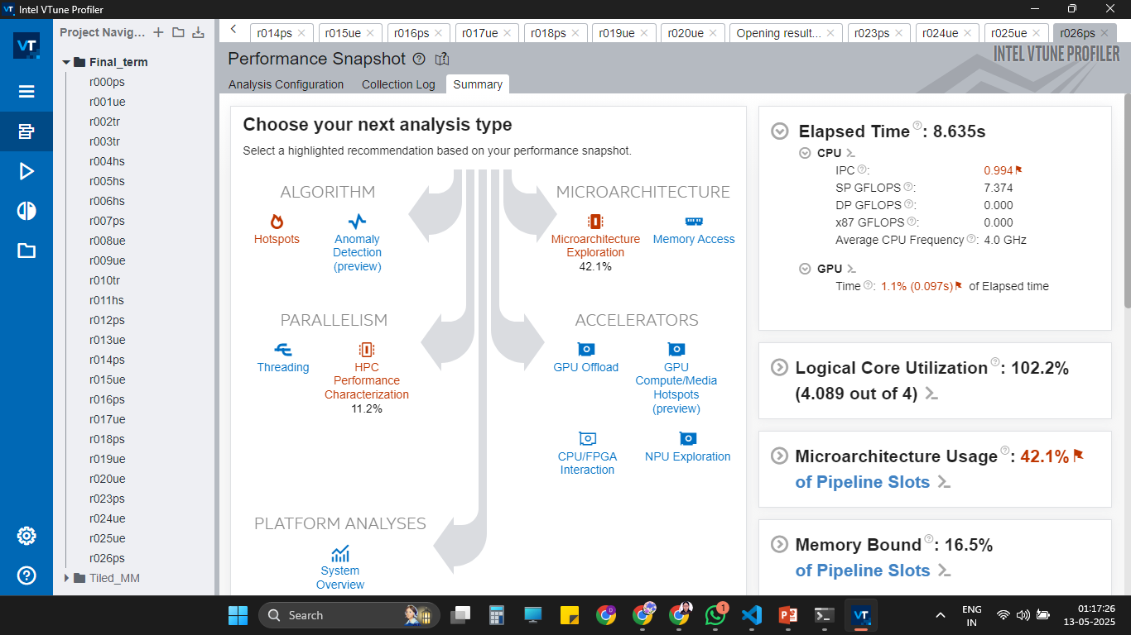
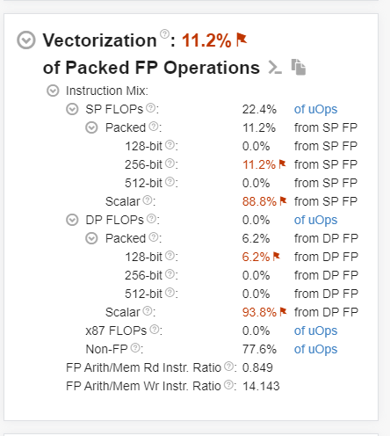

SIMD – single instruction multiple data vectorization : increasing parallelization
With SIMD
Without SIMD

Slide 27
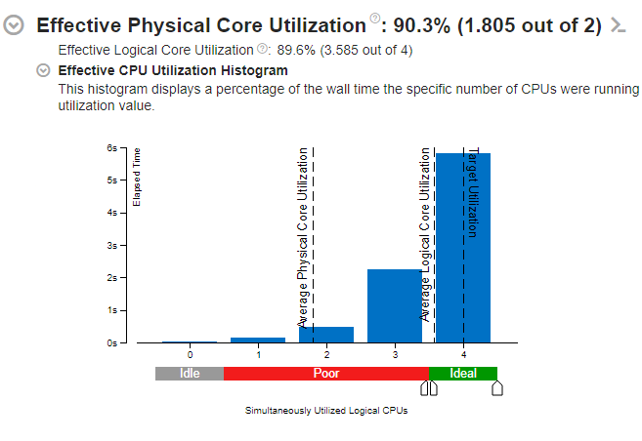
Performance Improvement ->

Slide 28
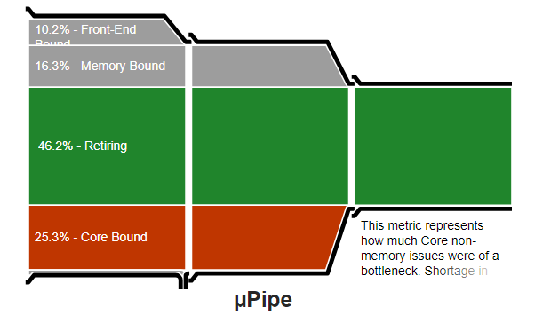

Slide 29
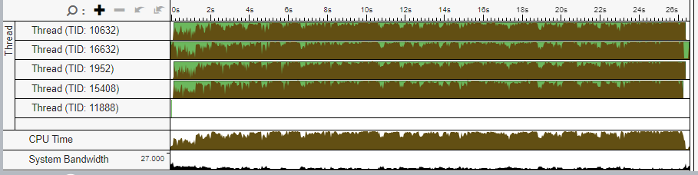
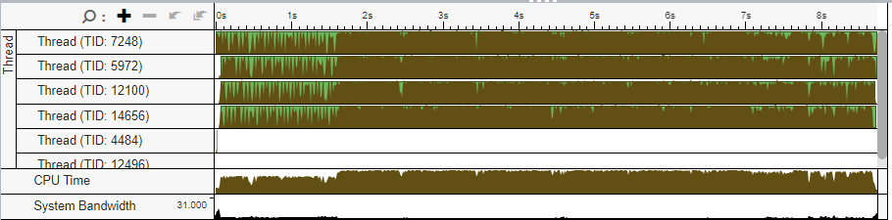
Performance Improvement ->

Slide 30

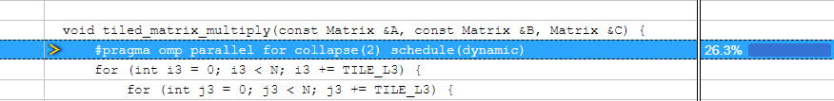
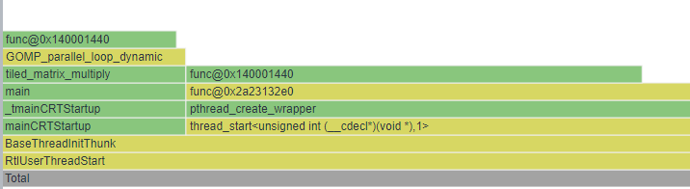
->
->

Slide 31
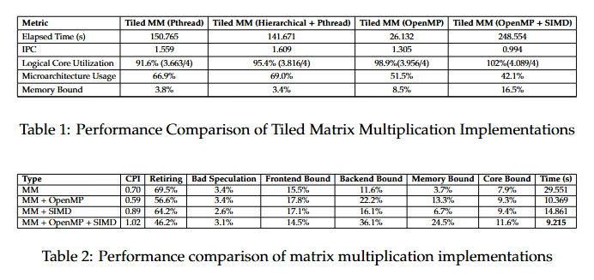

Slide 32
conclusion
Parallelization significantly improves performance – All multithreaded versions of tiled matrix multiplication (Pthreads, OpenMP) reduced execution time compared to the baseline, with high logical core utilization (>90%).
OpenMP with SIMD vectorization achieves the best performance – Among all variants, the combination of OpenMP and vectorization yielded the lowest elapsed time and highest IPC, indicating efficient instruction throughput and data-level parallelism.
Hierarchical tiling further optimizes cache usage – Introducing hierarchy in the tiled algorithm reduced memory-bound stalls slightly and improved microarchitecture efficiency.

Slide 33
Thank you

